Slide 1

Facebook Political Ads
Sarah Higgins John Sanders

Slide 2

Introduction

Slide 3
Introduction
Social Media is shaping political opinion
Organizations advertise heavily to large audience
Foreign interference? (Ex. 2016 election, Russian “troll farm”)

Slide 4

ProPublica

Slide 5
ProPublica
Browser Extension that collects thousands of ads from thousands of volunteer Facebook users, but hides their identities
Starts collecting ads as soon as users login
Open-Sourced, customized for several countries

Slide 6

The Data

Slide 7
The Data
Uses a Naive Bayes machine learning classifier to identify political ads
Features include: Id, Political_probability & targetedness
Updated daily

Slide 8
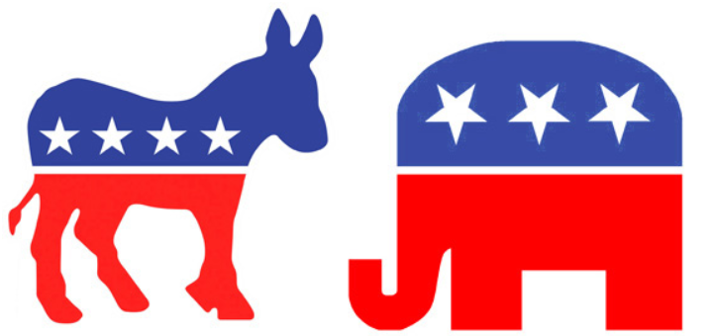
Questions to be answered

Slide 9
Questions to be answered
“How many ads in the dataset are political/non-political?
“How many ads were created per state?”
“How many ads were created per political party?”

Slide 10
PySpark & SQL Queries

Slide 11
PySpark & SQL Queries
Political Ads:
Non-Political Ads:

Slide 12
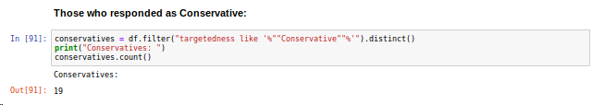
PySpark & SQL Queries
Query for each political party within the Targetedness column, count how many there are of each one

Slide 13

PySpark & SQL Queries
Query for each state within the Targetedness column, count how many there are of each one

Slide 14
Google Cloud Kubernetes Cluster

Slide 15
Google Cloud Kubernetes Cluster
Submit the job to the Google Cluster through command line interface after establishing Spark connection

Slide 16
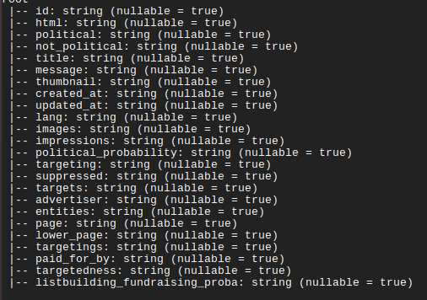
Google Cloud Kubernetes Cluster

Slide 17
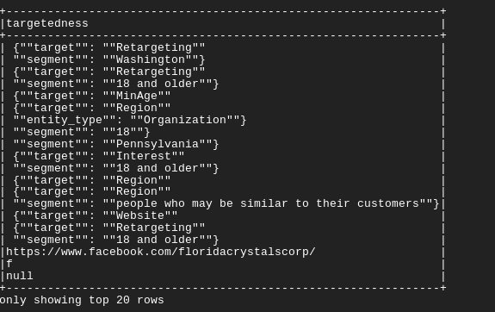
Google Cloud Kubernetes Cluster

Slide 18
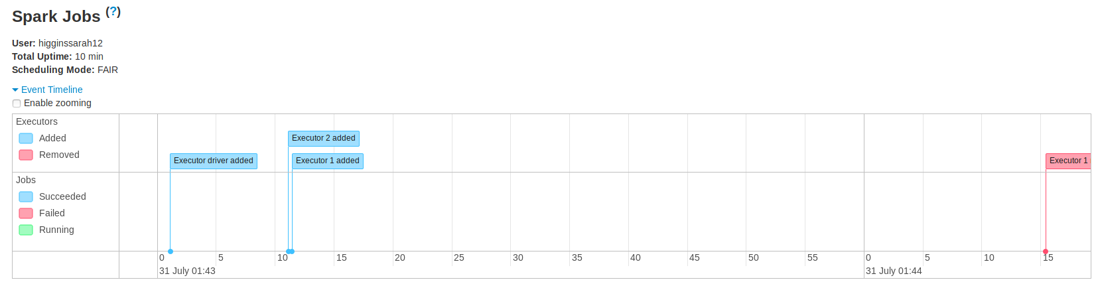
Google Cloud Kubernetes Cluster
Executors added and received all jobs from queries

Slide 19

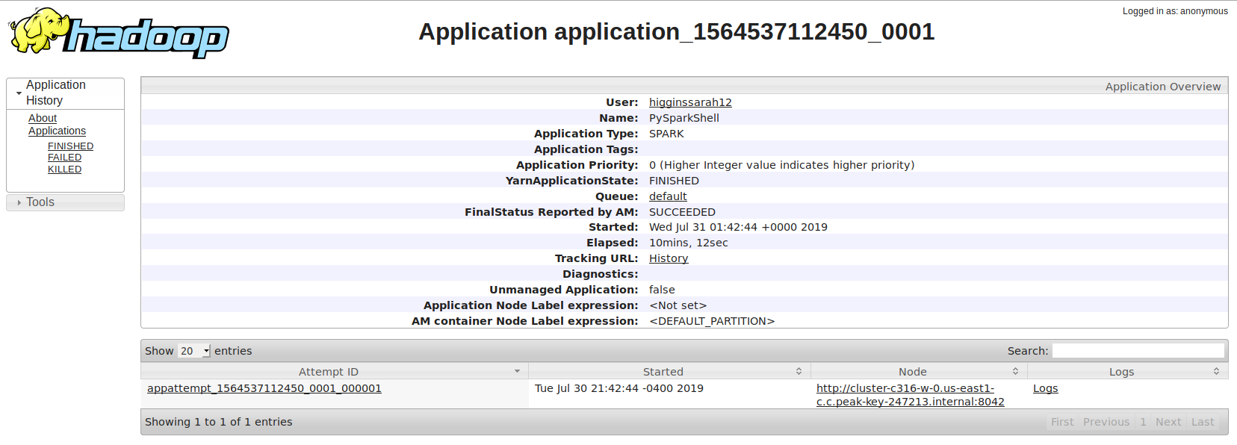
Google Cloud Kubernetes Cluster

Slide 20
Challenges

Slide 21
Challenges
Had trouble cleaning the data due to large size and inconsistent patterns per column
Many lines in the data are written in HTML code, difficult to munge through
Large dataset takes a long time to run on the cluster

Slide 22
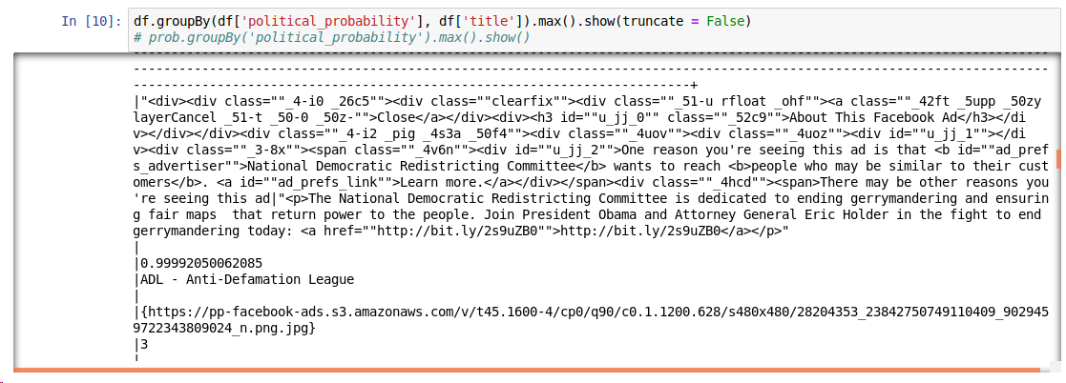
Challenges
Inconsistent pattern output example:

Slide 23
Results

Slide 24
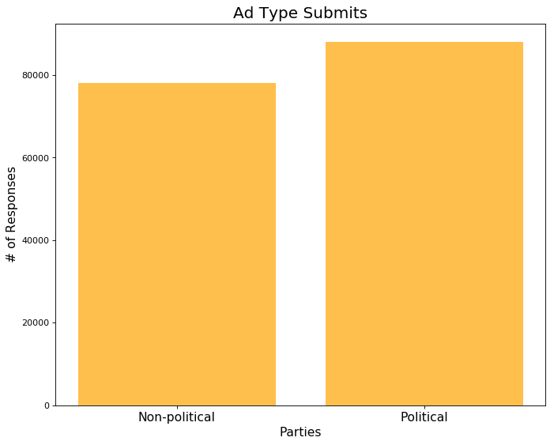
Results

Slide 25
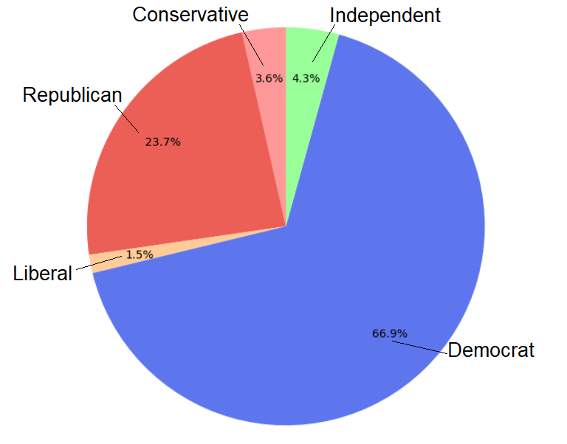
Results

Slide 26
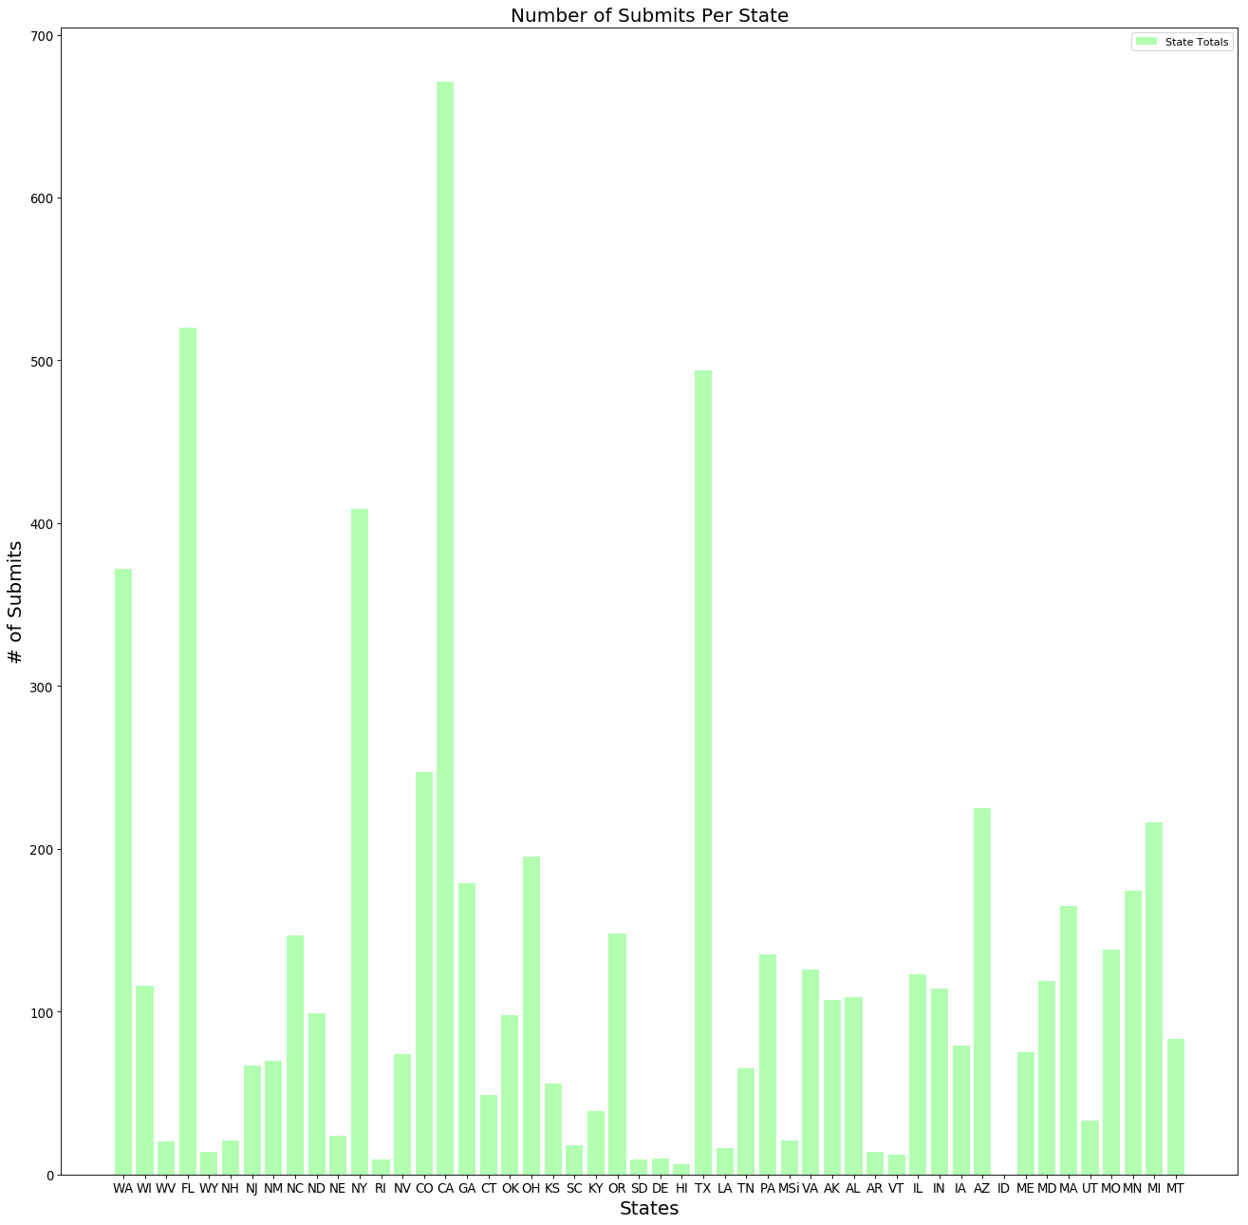
Results

Slide 27
Conclusions

Slide 28
Conclusions
More political ads being created than ever before
Many users contributed their ads received from key-political states (CA,TX & FL)
More unique/ distinct Democratic ads being seen by users post-2016 election

Slide 29
Questions?

Slide 30
Thank You!

